Slide 1

MM 2018
Deep Learning for Atomically Resolved Imaging
Maxim Ziatdinov
Institute for Functional Imaging of Materials
&
Computational Sciences and Engineering Division
August 5th 2018

Slide 2
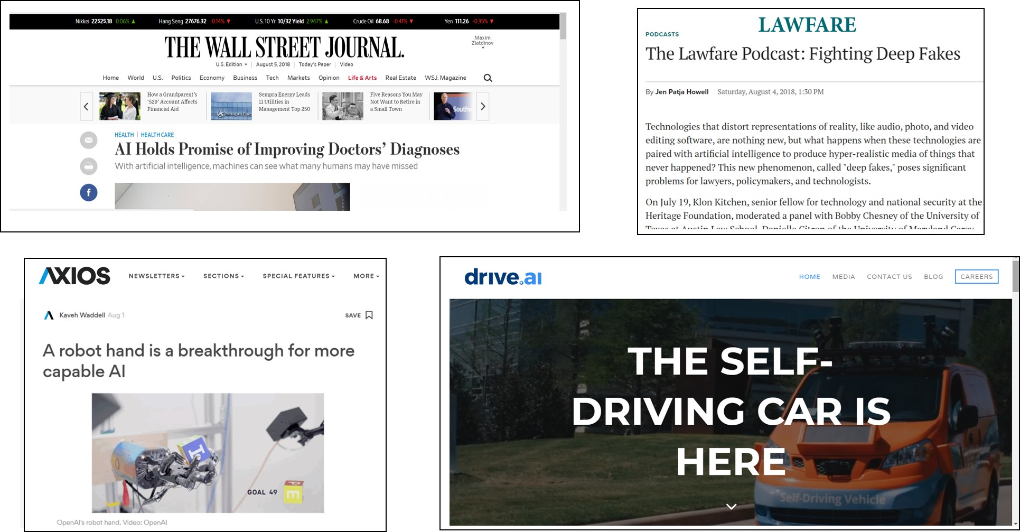
Deep Learning in Modern World

Slide 3
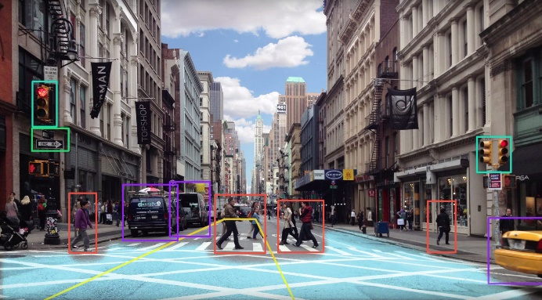
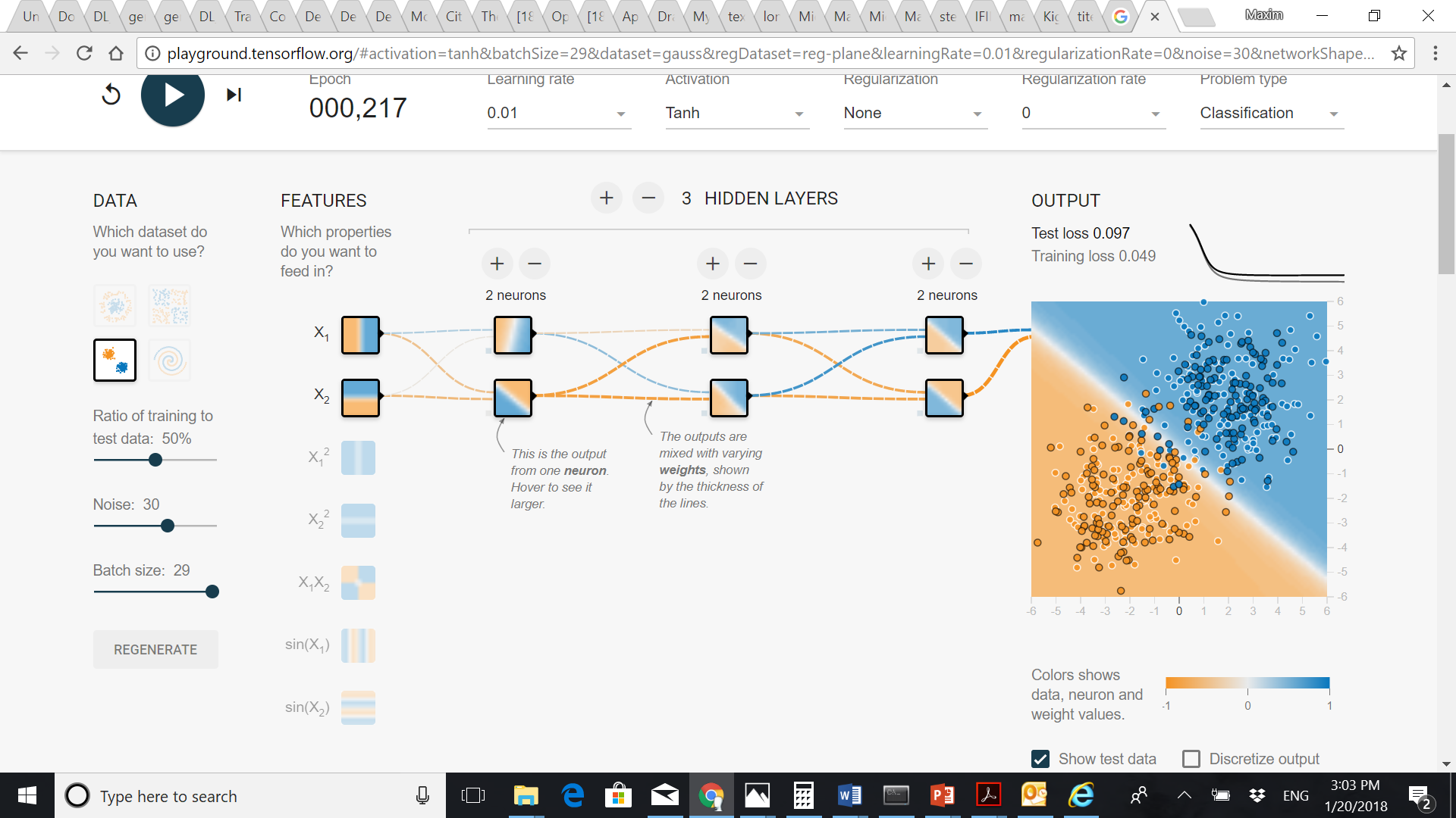
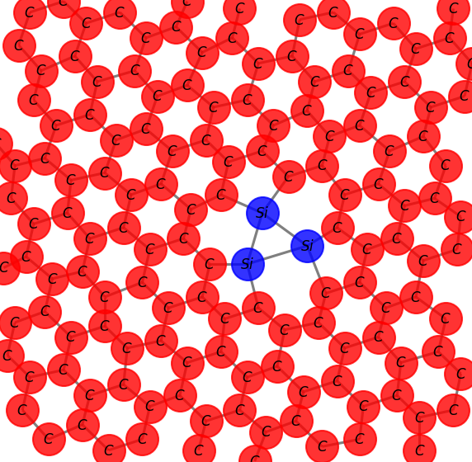
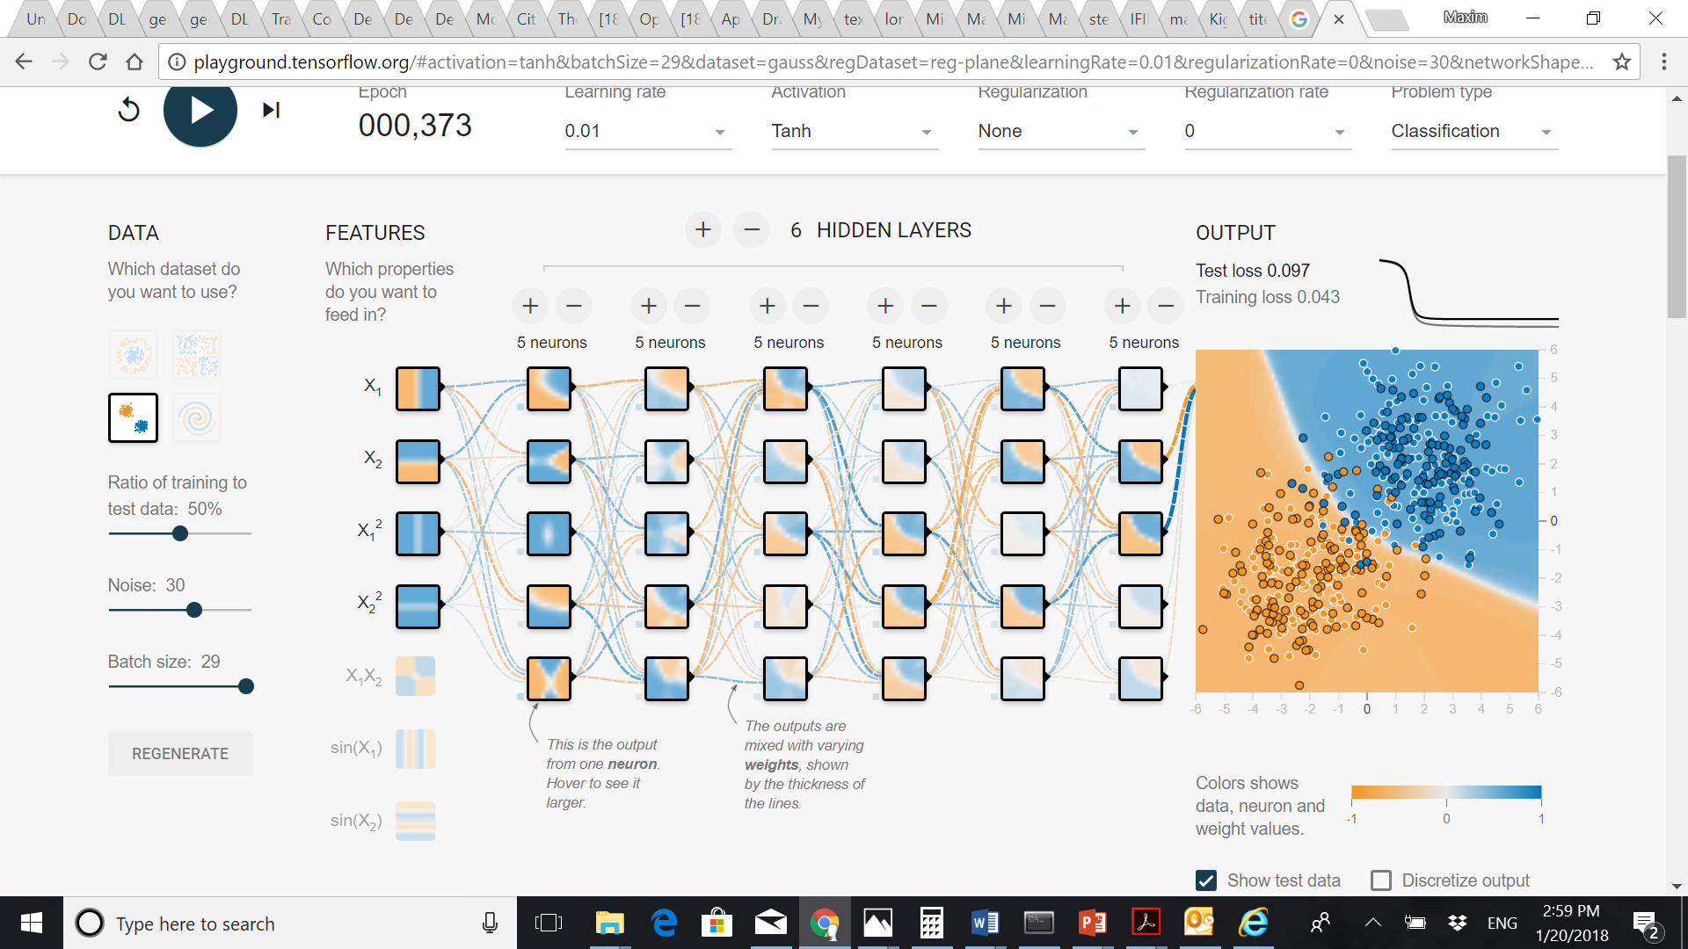
(Deep) Artificial Neural Networks
Macro-world vs. Nano-world:
Network is trained to match input to output by adjusting weights.
It can then generalize to data samples that were not part of the training set.
Macro-world
Shallow Neural Network
Small number of processing units/layers
Input
Input
Output
Output
Nano-world
Deep Neural Network (aka deep learning)
Large number of processing units/layers
Input
Output
The deeper networks are able to capture more abstract, high-level features

Slide 4
(Some) Deep Learning applications in theoretical condensed matter physics and materials sciences
Type of problem | Type of neural network | Training data/input type | Output (physics learned)
Phase transition in classical spin systems | Convolutional neural network [^{1,2}] | Labeled 2D images corresponding to equilibrium spin configuration (e.g. from Monte Carlo simulations) | Output neuron capturing transition temperature (prediction changes from 0 to 1 at T_{c})
 | Variational autoencoders [³] | Same but unlabeled | Latent variable and reconstruction loss correspond to order parameter
Identification of topological and trivial phases of matter | Fully-connected neural network (with pre-input ‘filter’ for quantum loop tomography) [⁴] | Labeled quasi-2D “images” made of un-averaged values of products of loop-forming operators that are relevant for the phase of interest | Output neuron is associated with “topological response” (prediction changes from 0 to 1 at k=0.5)
Differentiating between dynamical phases of a time-dependent model (Many body localization) | Recurrent neural network [⁵] | Magnetization time-traces | Output neuron recovers phase boundaries
Predicting materials properties (e.g. formation energy, band gap) directly from crystal lattice (graph) structure. | Graph convolutional network [⁶] | Atom feature vector (group number, covalent radius, valence electrons, etc.) and bond feature vector (atom distance) | Output neuron recovers continuous or discrete properties of material
Distinguishing different topological invariants | Convolutional neural network [⁷] | Labeled parameterized Hamiltonians | Output neuron corresponds to a winding number
Carrasquilla, J. & Melko, R. G. Machine learning phases of matter. Nature Physics 13, 431 (2017).
Tanaka, A. & Tomiya, A. Detection of Phase Transition via Convolutional Neural Networks. Journal of the Physical Society of Japan 86, 063001 (2017).
Wetzel, S. J. Unsupervised learning of phase transitions: From principal component analysis to variational autoencoders. Physical Review E 96, 022140 (2017).
Zhang, Y. & Kim, E.-A. Quantum Loop Topography for Machine Learning. Physical Review Letters 118, 216401 (2017)
van Nieuwenburg, E., Bairey, E. & Refael, G. Learning phase transitions from dynamics. arXiv preprint arXiv:1712.00450 (2017).
Xie, T. & Grossman, J. C. Crystal Graph Convolutional Neural Networks for an Accurate and Interpretable Prediction of Material Properties. Physical Review Letters 120, 145301, (2018).
Zhang, P., Shen, H. & Zhai, H. Machine Learning Topological Invariants with Neural Networks. Physical Review Letters 120, 066401 (2018).

Slide 5
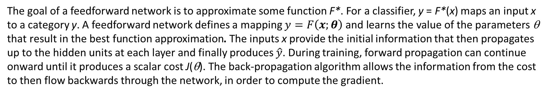
Deep feedforward networks
Forward propagation
Back propagation
The goal of a feedforward network is to approximate some function F*. For a classifier, y = F*(x) maps an input x to a category y. A feedforward network defines a mapping $y=F\left(x;θ\right) \text{and} \text{learns} \text{the} \text{value} \text{of} \text{the} \text{parameters} \text{θ} \text{that} \text{result} \text{in} \text{the} \text{best} \text{function} \text{approximation}$. The inputs x provide the initial information that then propagates up to the hidden units at each layer and finally produces $\hat{y}$. During training, forward propagation can continue onward until it produces a scalar cost J(θ). The back-propagation algorithm allows the information from the cost to then flow backwards through the network, in order to compute the gradient.
Goodfellow, I.; Bengio, Y.; Courville, A.: Deep Learning; The MIT Press, 2016

Slide 6


Slide 7
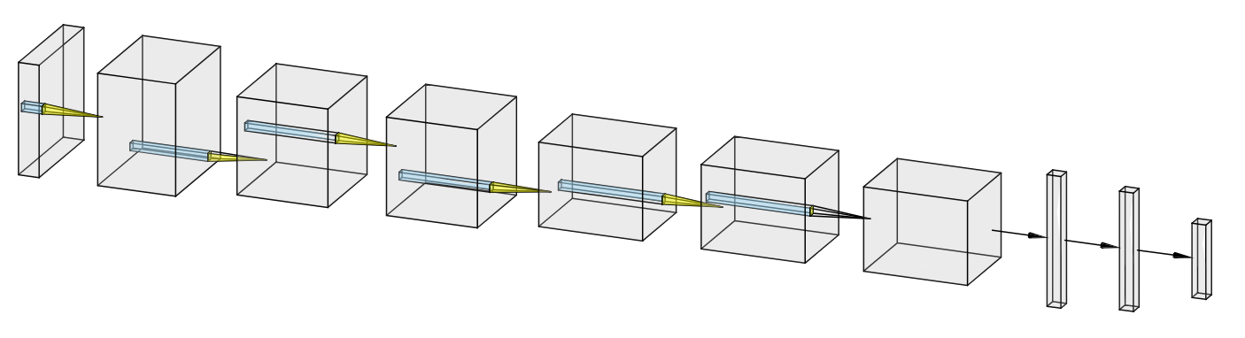
Convolutional neural network for image processing
Convolution
ReLU
Convolution
ReLU
Convolution
ReLU
Convolution
ReLU
Input
Convolution
ReLU
Convolution
ReLU
FC
FC
Softmax
MaxPooling
MaxPooling
MaxPooling
Feature learning
Classification
Convolutional neural networks (CNN) represent one of the key examples of a successful application of neuroscientific principles to the field of machine leaning.
Local connections: local values are correlated
Shared weights: local statistics is invariant to location
Pooling: merge similar features into one
Image of CNN is generated using network drawing tools at http://alexlenail.me

Slide 8
Convolutional layer
Accepts a volume of size w1×h1×d1
4 hyperparameters:
k: number of filters
f: size of filters (e.g. 3×3, 5×5, etc.)
s: stride
p: amount of zero padding
Outputs a volume of size w2×h2×d2:
w2 = (w1 – f + 2p)/s + 1
h2 = (h1 – f + 2p)/s + 1
d2 = k
Extracting local info ↔ physics
Input image/feature map from previous layer
Output feature map

Slide 9
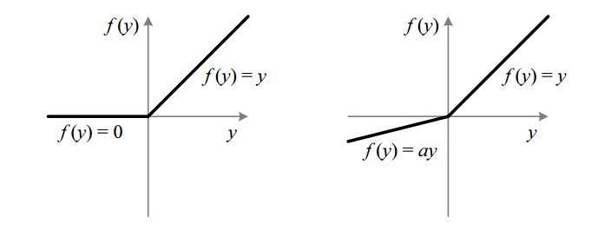
Activation Layer
Increases non-linearity of the network without affecting receptive fields of convolutional layers
Type of non-linear activations: ReLU, Leaky ReLU, Tanh, ELU, softmax, etc…
ReLU
Leaky ReLU

Slide 10
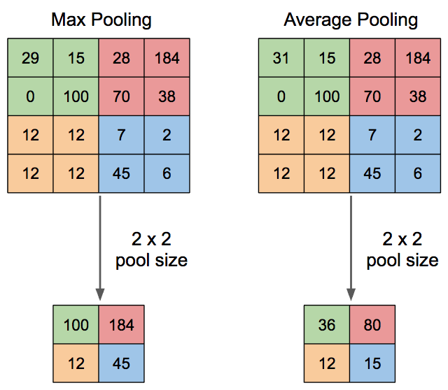
Pooling Layer
Accepts a volume of size w1×h1×d1
2 hyperparameters:
f: size (e.g. 2×2)
s: stride
Outputs a volume of size w2×h2×d2:
w2 = (w1 – f )/s + 1
h2 = (h1 – f )/s + 1
d2 = d1

Slide 11
Activation Layer: Softmax
Softmax activation layer is a special kind of layer used at the end of network to produce a discrete probability distribution vector

Slide 12
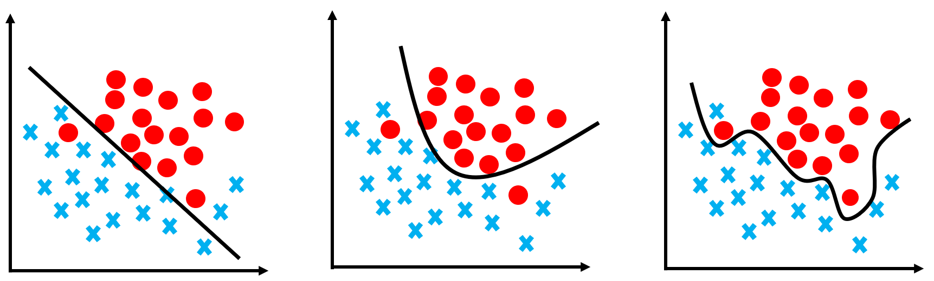
Regularization
Used to prevent overfitting
Types of regularization:
L1/L2
Dropout
Batch normalization
Max norm constraint
Underfitting
Appropriate
Overfitting

Slide 13
Dropout layer
Prevents overfitting by reducing correlations between neurons
During training, randomly ignores activations by probability p
During testing, uses all activations but scaled by p
Can be in principle used for uncertainty quantification
Goodfellow, I.; Bengio, Y.; Courville, A.: Deep Learning; The MIT Press, 2016

Slide 14
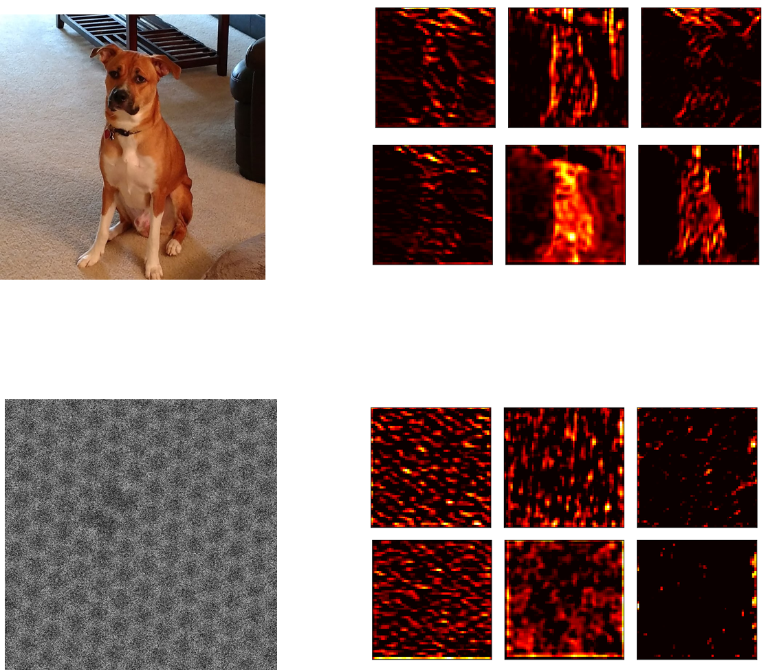
Importance of Training Set
VGG-19 pre-trained on ImageNet
Some feature maps
from intermediate layers
Top 3 predictions
Meet Duffy
Very close match
Staffordshire bullterrier 43 %
American pit bull terrier 23 %
Basenji 11 %
STEM of graphene
Some feature maps
from intermediate layers
Top 3 predictions
Doormat 22 %
Dishrag 5 %
Poncho 4 %
These are not the features we are interested in!
Notes:
The second key aspect is creation of a proper training set. Now this is something that I must state very clearly to avoid any future possible confusion. We cannot use the existing, pre-trained DL models for our problems. Let me illustrate this point. If I want a deep learning model to tell me a breed of my dog, I just take photo of my dog and use it as input into a deep learning model. Than model correctly identifies its breed. But if I take an experimental image of atomic lattice and use it as an input, than the output of the metwork won’t make any sense. Very powerful feature extractor was not able to find atoms in graphene lattice!! There is no database that would allow us to train a model for identifying atomic species and various types of defects. This represents a unique opportunity for us to teach some physics to neural network.

Slide 15
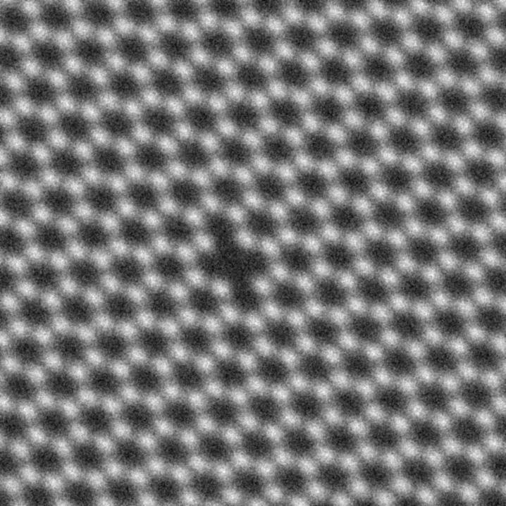
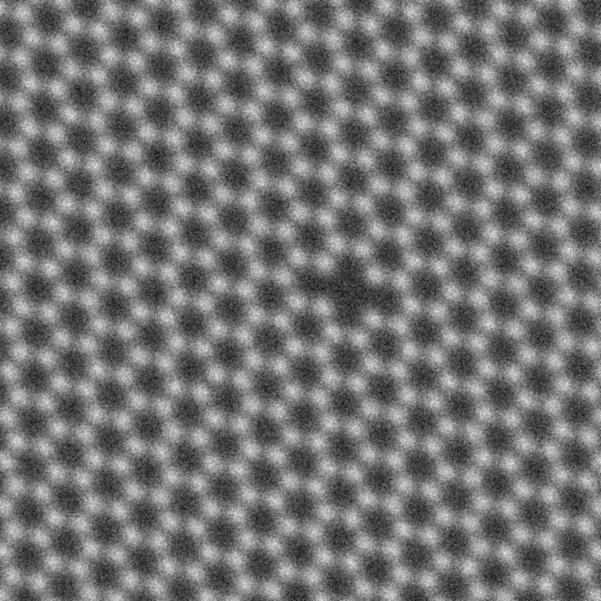
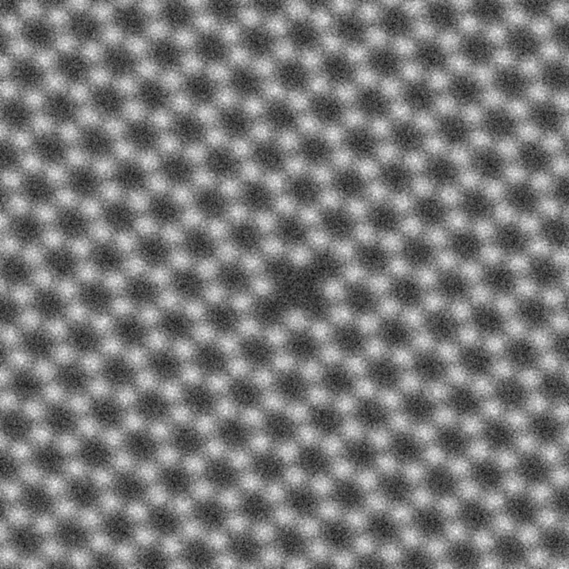
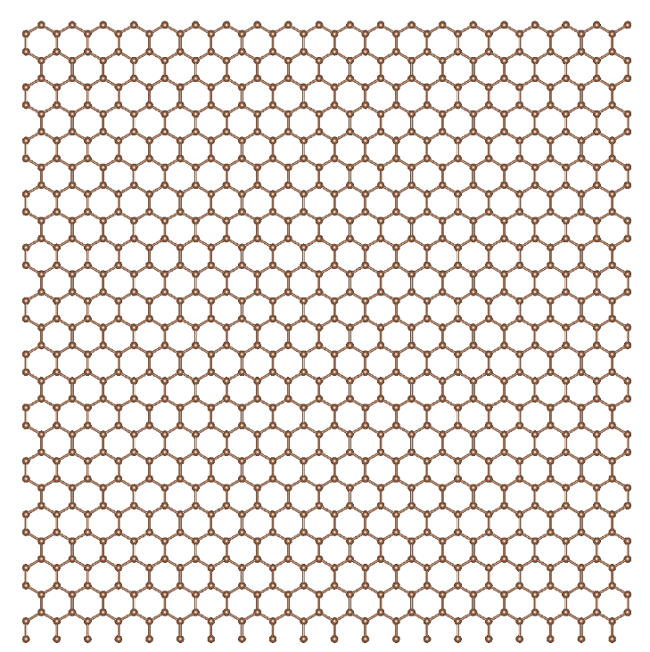
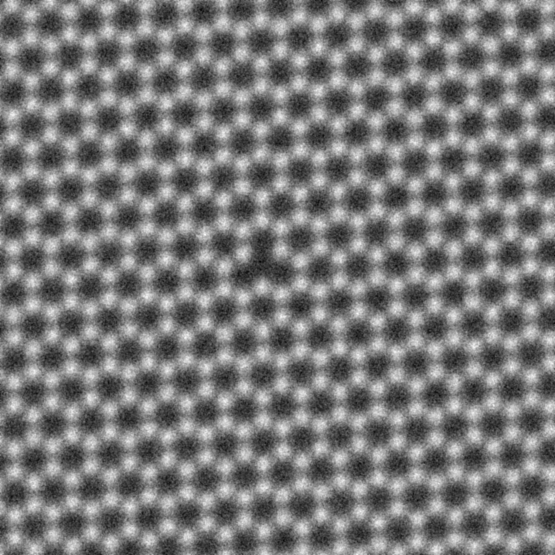
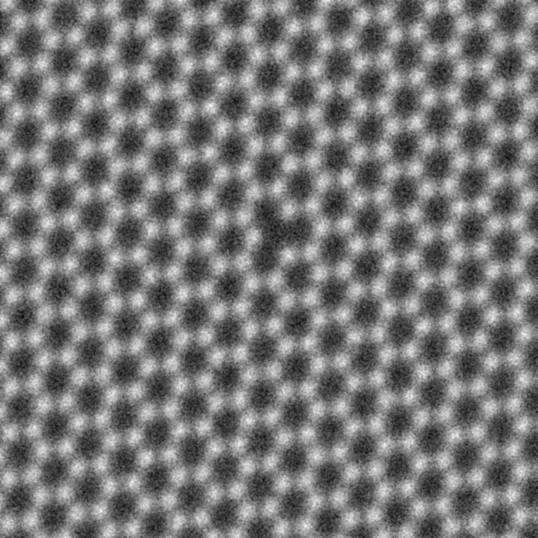
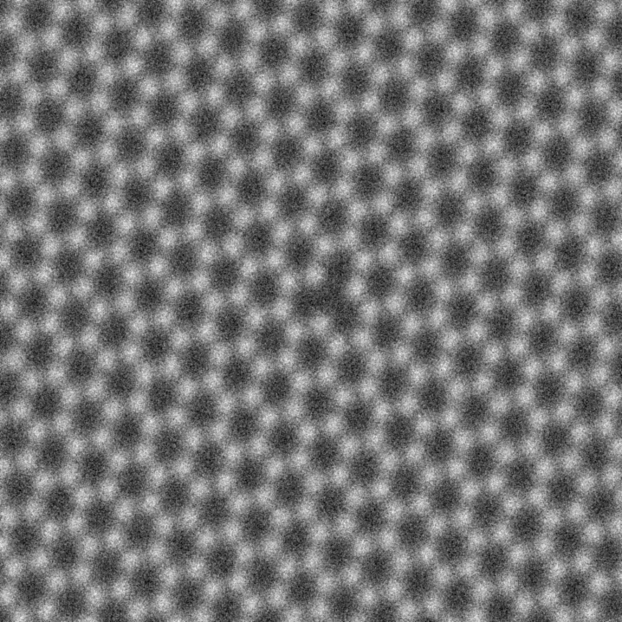
Training Set: Teaching atomic imaging concepts to neural networks
Atomic coordinates
(“ground truth”)
Simulated (and augmented) data
0
1
0
0
0
QM electron scattering
QM electron tunneling
0
0
1
0
0
Data augmentation:
- random shifts
- rotations
- zoom-in/out
- local atom displacements
- shear transformations
- adding noise, blurring
to account for variations in imaging conditions during real data acquisition
Notes:
How do we teach neural network to recognize physically-meaningful features in the image? We take atomic coordinates and…

Slide 16
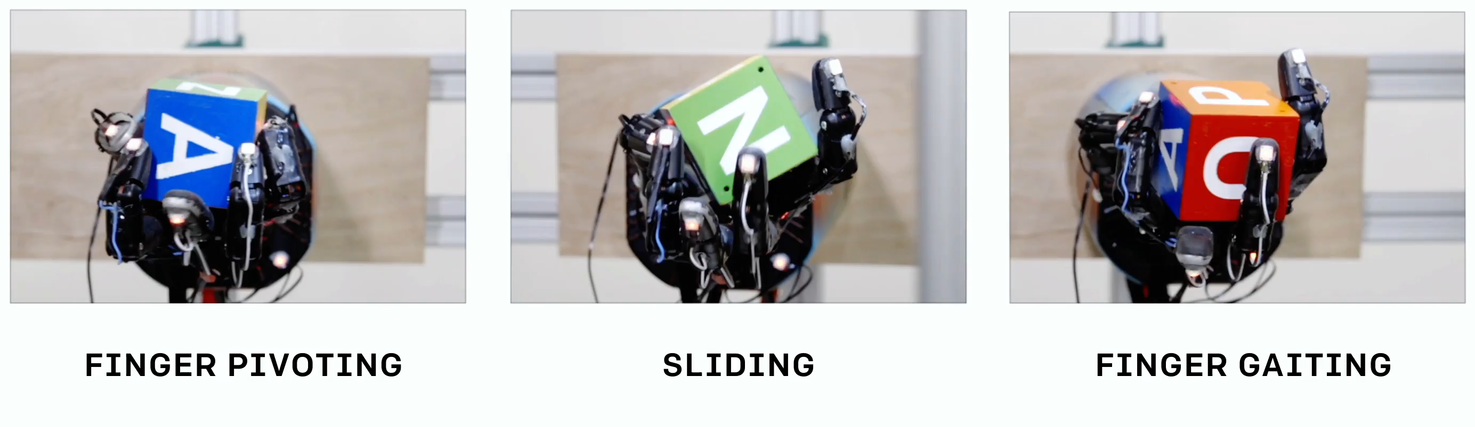
Simulations-to-physical-world knowledge transfer
https://blog.openai.com/learning-dexterity/
“Dactyl learns to solve the object reorientation task entirely in simulation without any human input. After this training phase, the learned policy works on the real robot without any fine-tuning.”

Slide 17
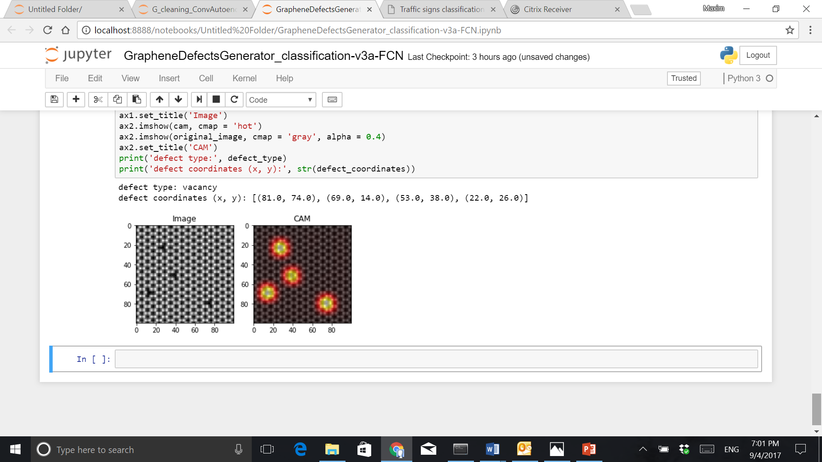
CNN-based classification of atomic structures
Convolution
ReLU
Convolution
ReLU
Convolution
ReLU
Convolution
ReLU
Global Average Pooling (GAP)
Input
Convolution
ReLU
Convolution
ReLU
MaxPooling
MaxPooling
MaxPooling
Feature learning
Classification
Example: CNN + dense layers
vs. CNN+GAP
Class activation maps (CAM)
(Free) localization of atomic-scale objects in image-level classification scheme!
Softmax weights
Final activation layer

Slide 18
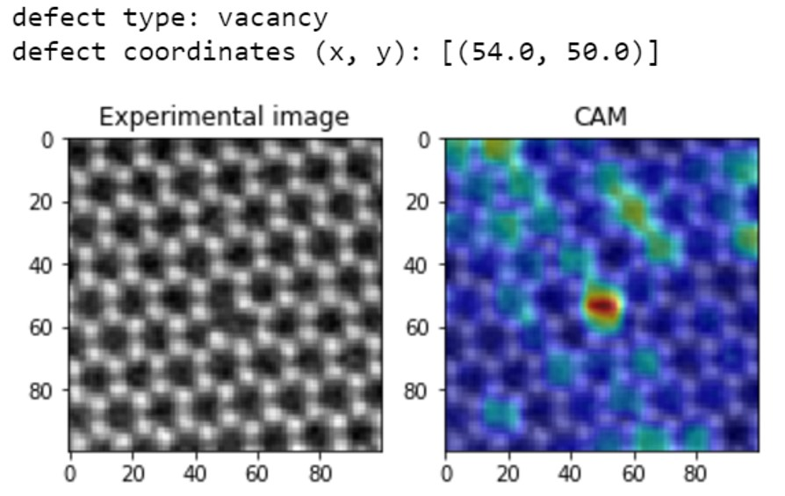
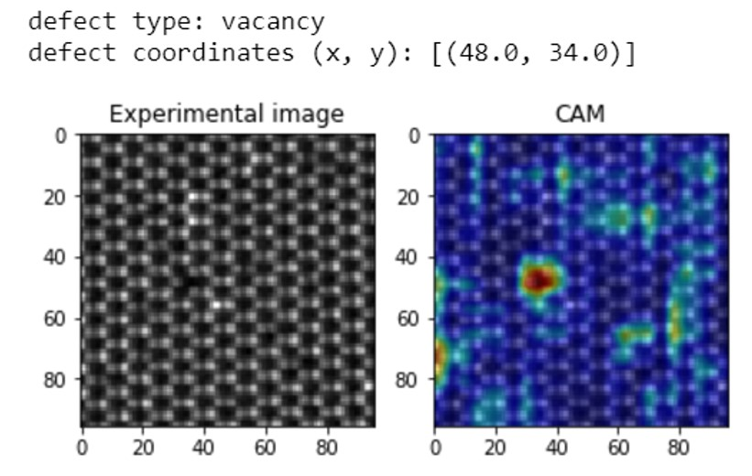
Localization of lattice defects via class activation maps technique
Real (experimental) data
Good generalization ability: We use our network to look for certain types of defects beyond the simple synthetic system and even material (!) on which it was trained.
Graphene
Mo1-xWxSe2
Defect type: Vacancy
Defect coordinates: (x, y) = (50, 54)
Defect type: Vacancy
Defect coordinates: (x, y) = (34, 48)

Slide 19
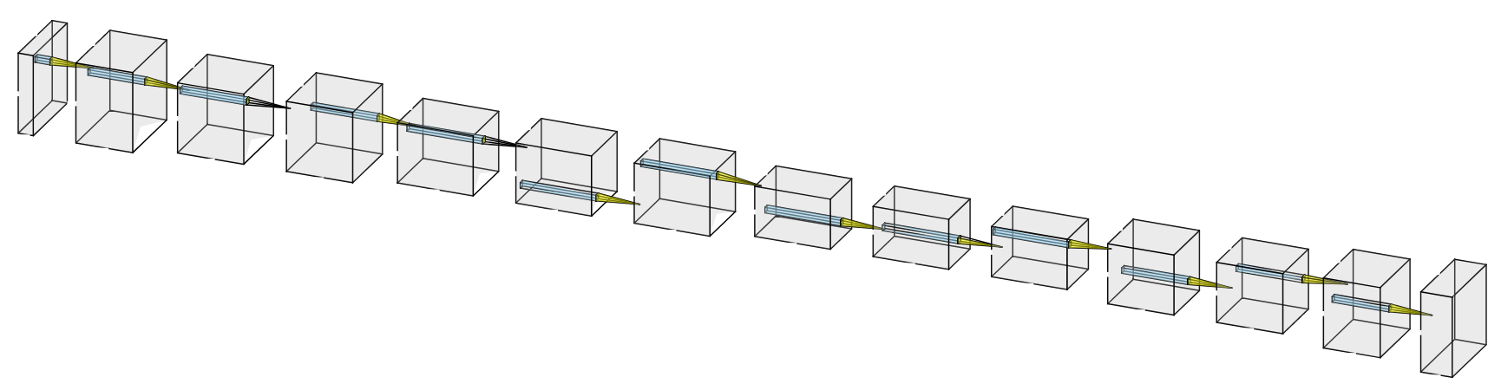
Fully convolutional neural network for pixel-wise classification
It is crucial to be able to learn precise location of atomic species and/or defects
The output of the DL model must provide the probability of each pixel belonging to certain atom and/or defect and its resolution/size should match that of the input image
Convolution
ReLU
Convolution
ReLU
Input
Convolution
ReLU
Convolution
ReLU
Convolution
ReLU
Convolution
ReLU
Convolution
ReLU
Convolution
ReLU
Convolution
ReLU
Convolution
ReLU
MaxPooling
Convolution
ReLU
MaxPooling
Convolution
ReLU
MaxPooling
Upsampling
Pixel-level
classification
Convolution/encoding
Upsampling
Upsampling
“Deconvolution”/decoding
Image of CNN is generated using network drawing tools at http://alexlenail.me

Slide 20
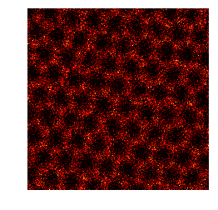
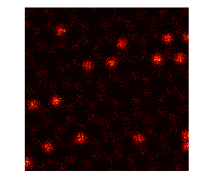
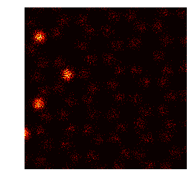
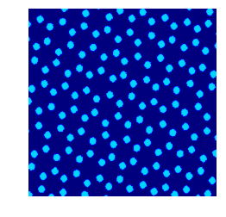
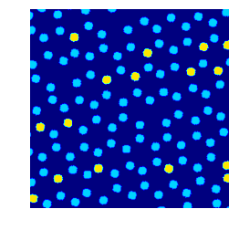
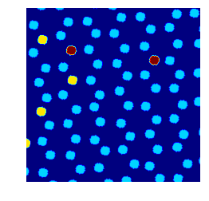
Training Set: Teaching atomic imaging concepts to neural networks
Atomic coordinates
(“ground truth”)
Simulated data
QM electron scattering
QM electron tunneling
Ground Truth
One may count vacancy as a separate class
Data augmentation:
- random shifts
- rotations
- zoom-in/out
- local atom displacements
- shear transformations
- adding noise, blurring
to account for variations in imaging conditions during real data acquisition
Notes:
How do we teach neural network to recognize physically-meaningful features in the image? We take atomic coordinates and…

Slide 21
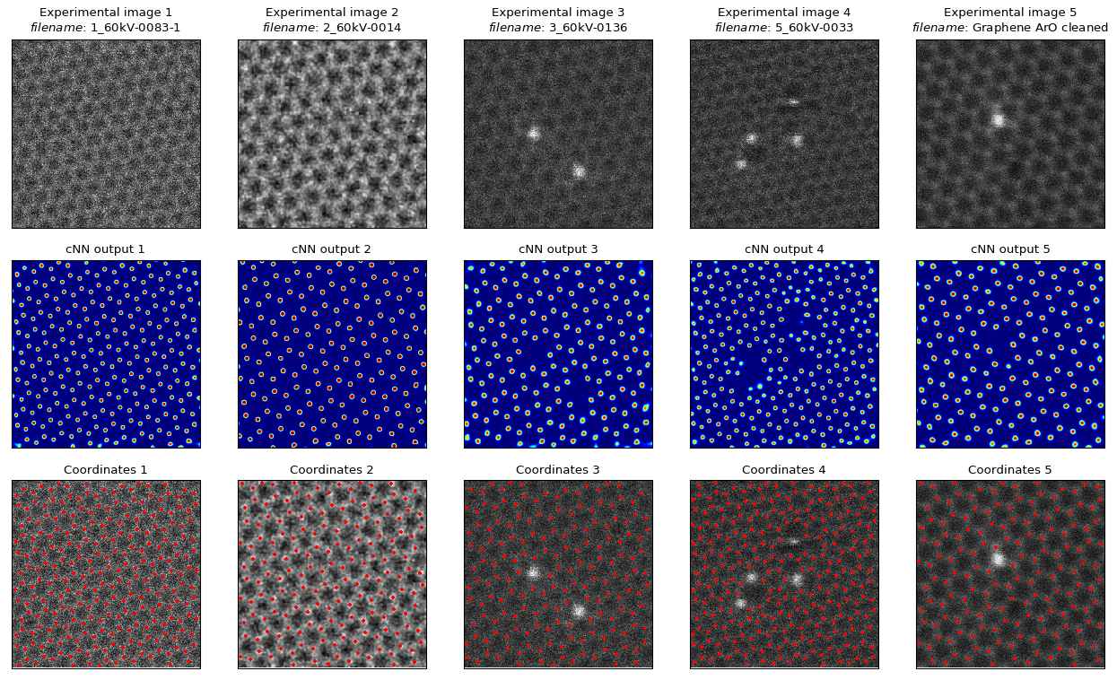
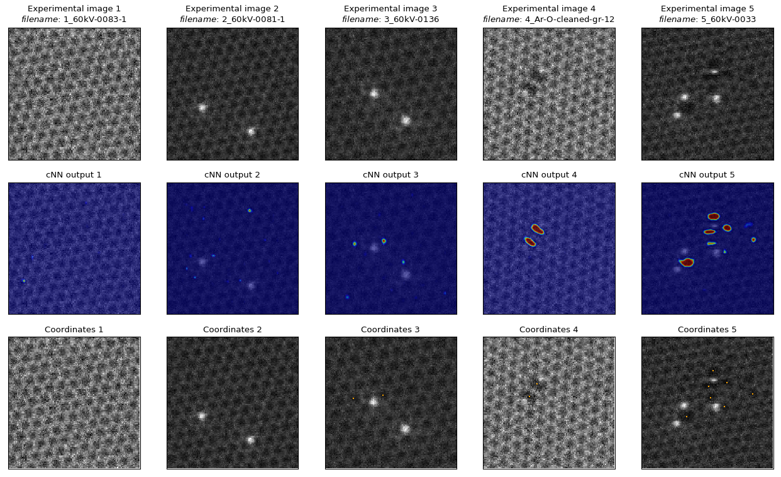
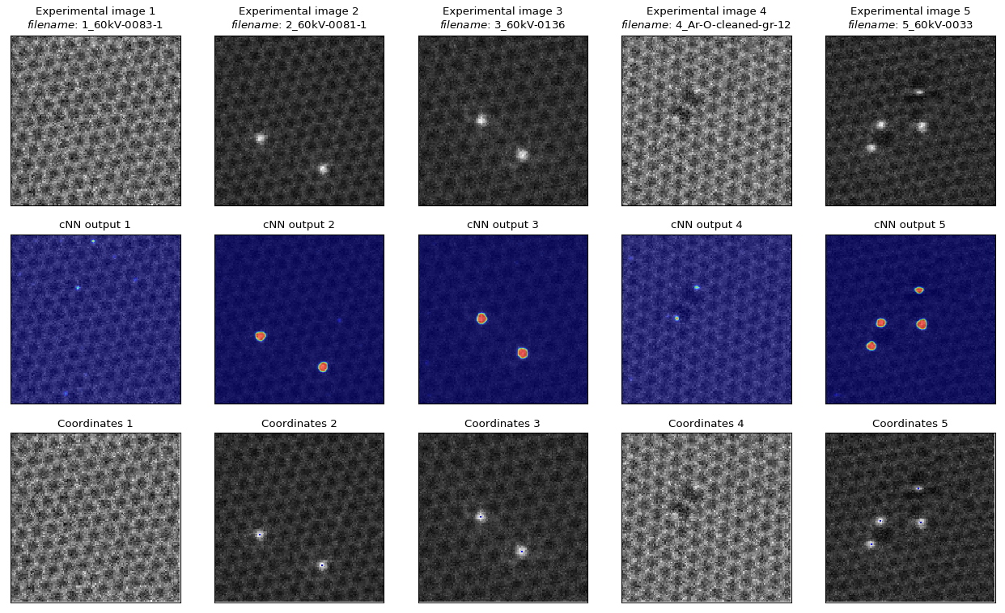
Finding lattice atoms and defects in graphene via deep learning
Experimental (raw)
Class ‘lattice’
Topological defects
(“anomaly”)
Class ‘vacancy’
Class ‘dopant’
How does DL model find all the atoms?
When tasked with finding atomic positions the deep neural network considers what is known as deep, high-level features in the image such as the shape of an individual hexagon, as well as shapes of its neighbors.
Ziatdinov et al., ACS Nano 11, 12742 (2017)

Slide 22
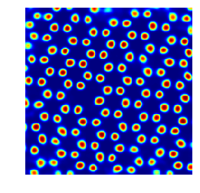
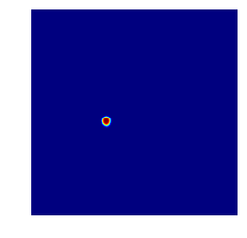
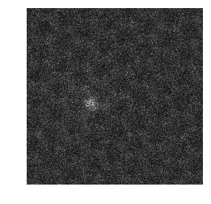
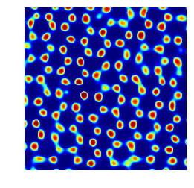

Importance of model architecture: Average pooling vs. Max Pooling
Channel 0
Channel 1
Experimental data
Max pooling
Channel 0
Channel 1
Average pooling

Slide 23



Some useful resources (personal advice)
Deep Learning libraries
Computational Recources
Deep Learning Books
Most of the researchers in the field are very active on Twitter, Facebook, Linkedin…

Slide 24
Please also check the Notebooks for some simple implementations of DL models for finding atoms

